Slide 1
Owen’s Project: TalkingData Mobile User Demographics Lightning Talk
7/19/2016

Slide 2
The Problem
TalkingData, China’s largest mobile data platform is seeking to leverage behavioral data from more than 70% of the 500 million mobile devices active daily in China to help its clients (advertisers) better understand and serve their audiences.
Advertisers want to surface better, more targeted, more relevant ads to the audiences.

Slide 3
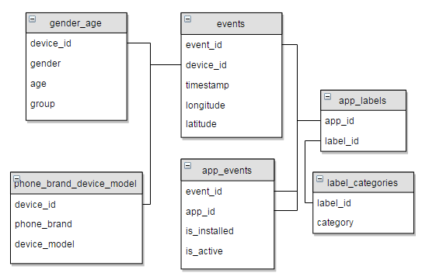
The Data
Star schema centered around events table (when a user uses TalkingData SDK, the event gets logged here. Each event has an id, location (lat/long), and the event corresponds to a list of apps in app_events)
Six relational tables convertible to a flat table

Slide 4
The Data
50+ phone_brands, all in Chinese - need translation:
三星 samsung
天语 Ktouch
海信 hisense
联想 lenovo
欧比 obi
爱派尔 ipair
努比亚 nubia
优米 youmi
朵唯 dowe
黑米 heymi

Slide 5
The Hypothesis
Given the business problem and the available data, I will need to build a model to predict users’ demographic characteristics based on their app usage, geolocation, and mobile device properties.
Success would be measured by the accuracy of the model and ultimately the performance of the improved, targeted ads.

Slide 6
Problem 2 & Problem 3
Given a bunch of baseball player and team statistics. Can we predict which teams will make the playoffs? And which team will win the World Series?
Given atmospheric data, can we predict the weather?

